Slide 1

Grid Service Development
Shannon Hastings
shannon.hastings@osumc.edu
Ohio State University
Novartis caGrid Training
Washington D.C.
June 2009

Slide 2
Overview
Introduce Toolkit
Grid Services Architecture
Introduce Generated Services
Service Extensions
Extension Development
Tutorial

Slide 3
Introduce
A framework which enables fast and easy creation of Globus and Standards based grid services.
Provide easy to use graphical service authoring tool.
Hide all “grid-ness” from the developer.
Utilize best practice layered grid service architecture.
Handle all core service architecture requirements for strongly typed and highly interoperable grid services.
Toolkit for creating and manipulating strongly typed grid services
Command line and GUI tools for service skeleton generation and automatic service/client code generation
Utilizes other core grid services and architecture components
caDSR and GME for schemas of registered data types
Security service architecture (Dorian, GridGrouper, CSM)
Advertisement and Registration configuration and
Index Service for discovery

Slide 4
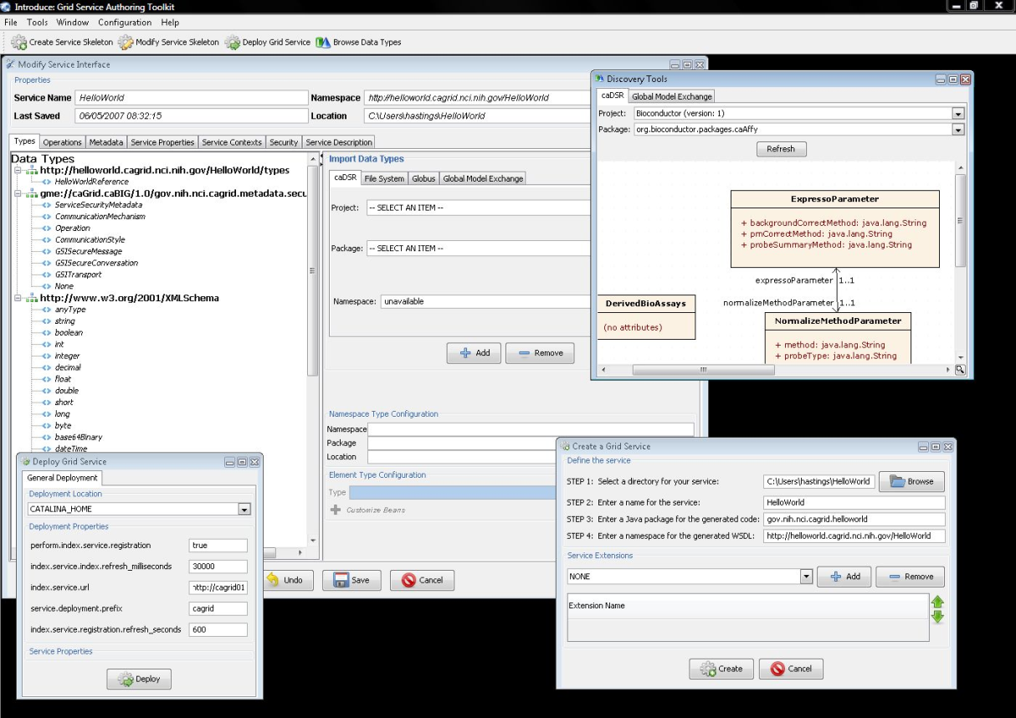
Introduce Graphical Development Environment (GDE)
GUI for creating and manipulating a grid service
Provides means of simple creation of service skeleton that a developer can then implement, build, and deploy
Automatic code generation of complete WSRF compliant grid service which is configured to provide:
Security
Advertisement
Discovery
Complete UnBoxed Client API
Provides a set of tools which enable the developer to add/remove/modify/import methods of the service as well create sub-services/resources.
Automatic code generation of all the required code, Globus grid service code/configuration, service configuration, implementation of the client, and stubbed implementation of the service

Slide 5
Introduce Requirements
Utilize best practice layered grid service architecture
Enable development of strongly-typed services
discovery and use of published data types
self describing services through use of metadata
advertisement and registration configuration with Index Service
Generate meaningful object-oriented client APIs
Customizable and extensible via the use of plug-ins
Allow for implementation of secure services
provide customizable service-, method-, and resource- level security

Slide 6
Addressing the Requirements
Grid Services
Introduce uses the Globus Toolkit and Axis for creating, registering, discovering, and invoking these service operations as grid services
Client uses the operation through a grid service interface and does not need to be aware of any implementation specific details of the grid service

Slide 7
Service Layers

Slide 8
Addressing the Requirements (cont)
Strongly typed interfaces:
Introduce enables schema extraction from a GME or any other data model registry service so that the wsdl, beans, and service metadata can be automatically populated and the service will be using strongly typed with publicly accessible data types.
Data model schema, and any referenced schemas, are extracted and placed in the schema directory of the services build skeleton and imported into the services WSDL.
types can be used at service build time to automatically generate the objects and create strongly-typed grid service interfaces
Example from caGrid

Slide 9
Addressing the Requirements (cont)
Providing Service Metadata:
Leverage Globus’ use of Java Naming and Directory Interface (JNDI).
Service metadata is provided as resource properties on the base service’s singleton resource.
These resource properties are defined by xml schema.
The resource properties on the base service can be registered to the index service as service metadata.
This metadata can then be queried from the index service and used to locate particular services of interest.

Slide 10
Addressing the Requirements (cont)
Index Service Registration
Leverage Globus MDS in order to configure properties on the base resource of the service to be published to an MDS based Index Service.
Provide configuration options for registration of static and dynamic service metadata which can then be used at runtime for service discovery.
Example from caGrid

Slide 11
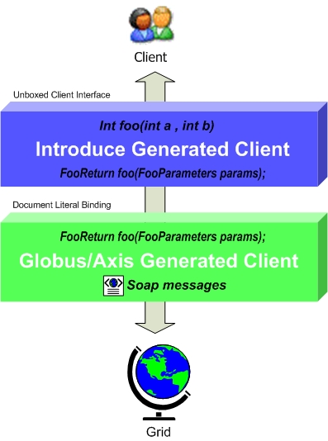
Addressing the Requirements (cont)
Providing Client Side Object Oriented API
Globus/Axis build process will automatically generate a client side object oriented API which is document literal.
Introduce generates a wrapper for this API which matches the service designers rpc style interface to make a clean mapping from client to service.
This wrapper will handle auto boxing/unboxing of the parameters into and out of document literal form.

Slide 12
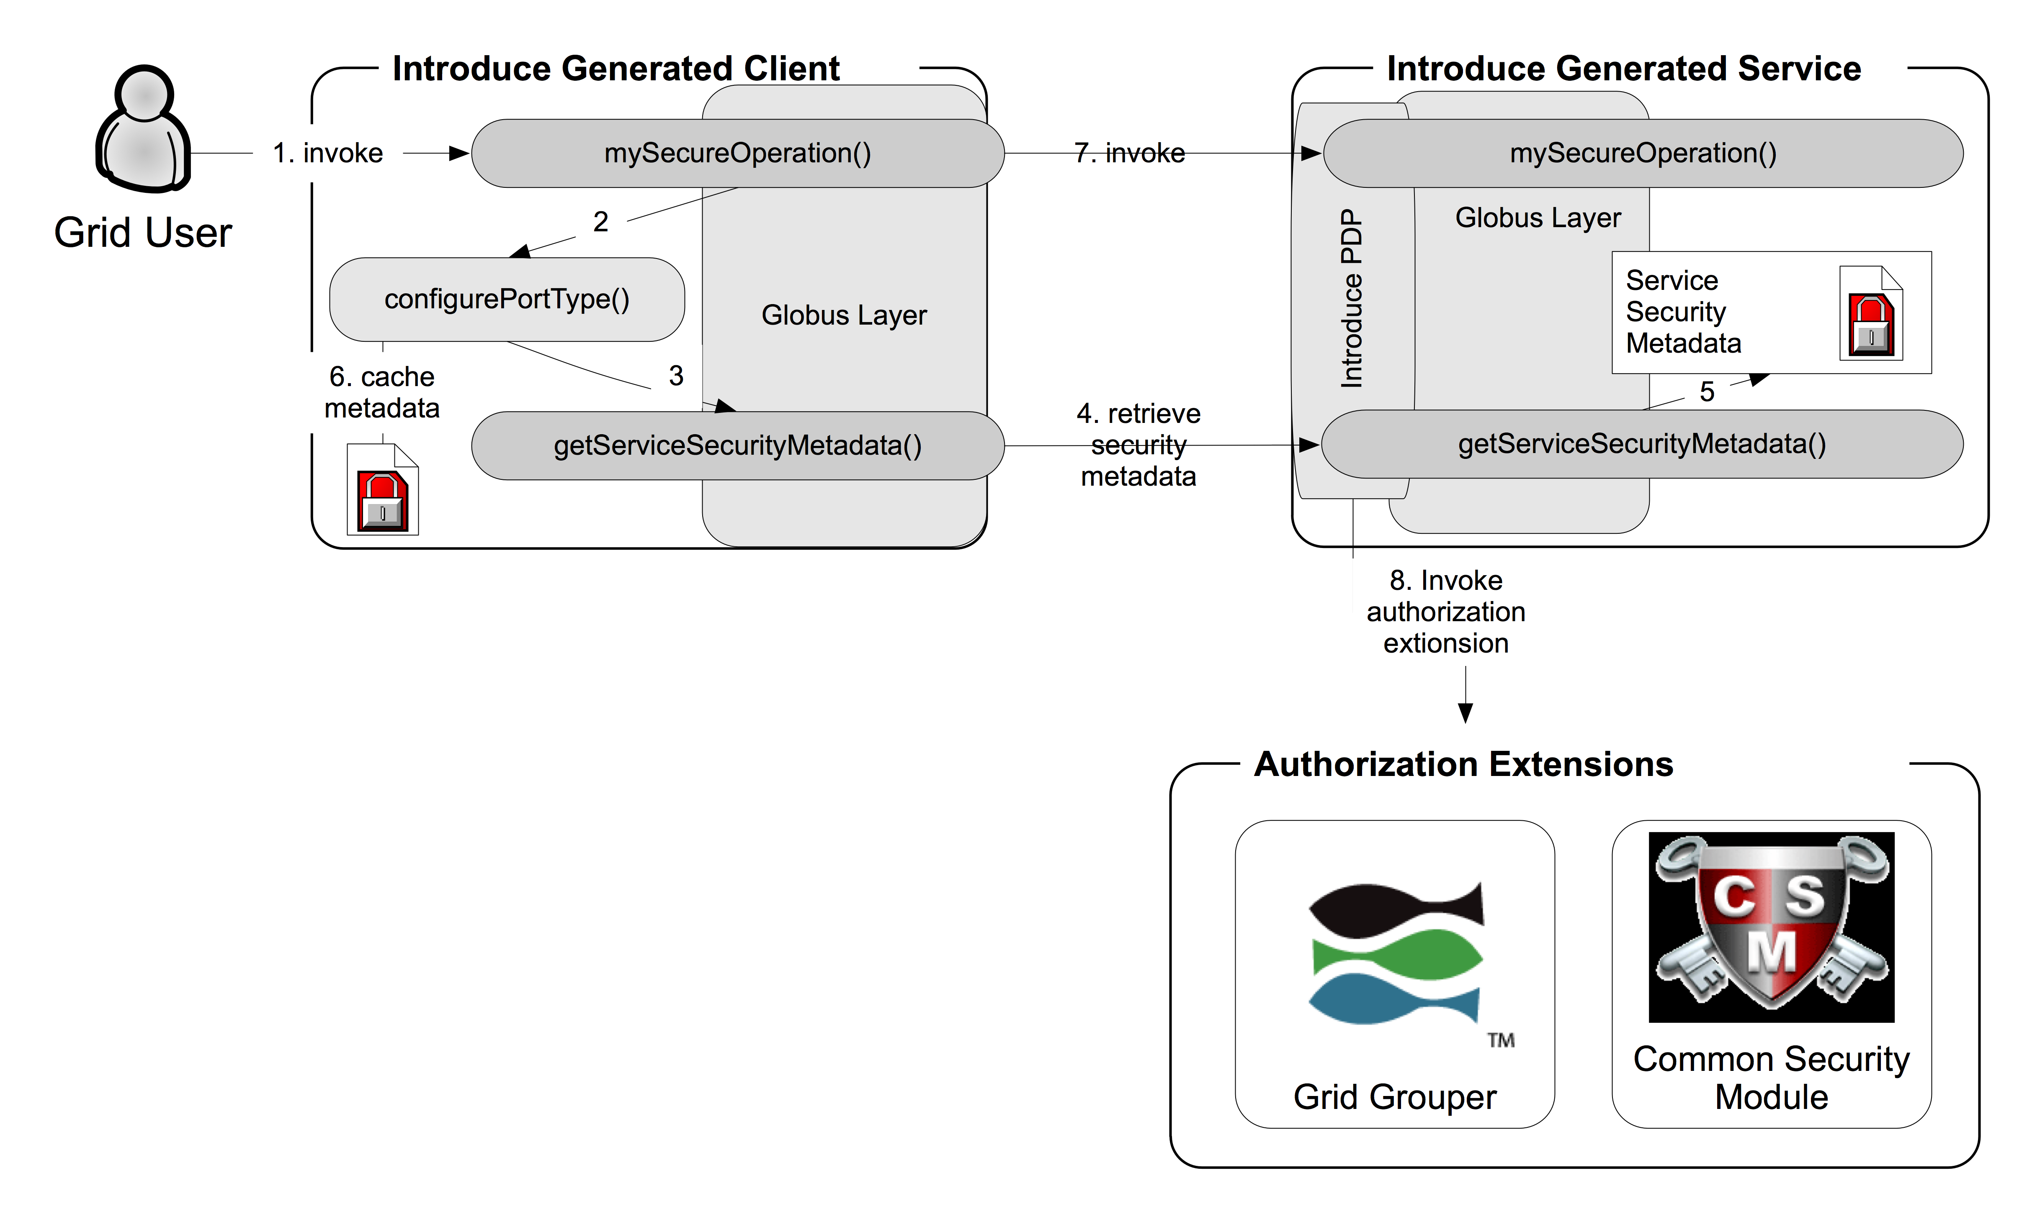
Addressing the Requirements (cont)
Security:
Enable configuration for each service and for each method in a service so the client can utilize this metadata to configure itself for connecting to the service.
Support complete GSI security configuration for authentication and support for an authorization plug-in framework.
Require service security metadata to be available anonymously via the grid service interface (getServiceSecurityMetadata()) or the grid service’s resource properties.
Introduce generated clients will automatically retrieve this metadata and use it to configure the client before making a call to the service.

Slide 13
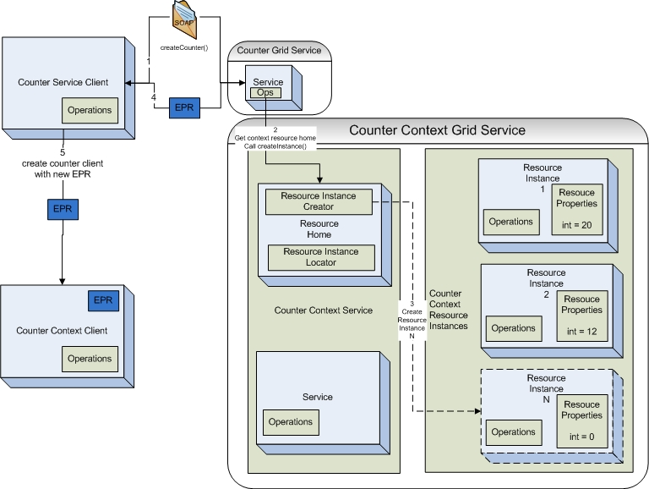
Introduce Service Resource Contexts
Enhanced Resource Pattern Support
Introduce supports automated code generation for resource creation so that factory patterns can be easily used in the service.
If an operation of a service returns a type EPR of another service Introduce will automatically generate the factory code that is required in the operation implementation.

Slide 14
Addressing the Requirements: Extensible Architecture
Introduce provides an extension framework where it’s core functionality can be extended to provide customized solutions by leveraging the Introduce toolkit.
There are many types of extensions in Introduce that can be added to the toolkit.
Service
Types Discovery
Authorization
GDE
Deployment
Extensions provide an “extension.xml” extension description and configuration. The “extensions” directory of introduce hold the extensions in separate folders enabling them to easily be added and removed from the Introduce toolkit.

Slide 15
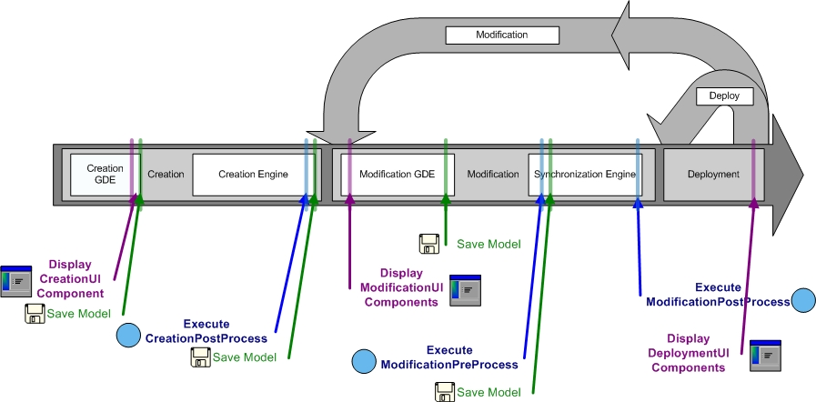
Addressing the Requirements: Extensible Architecture (cont)
Flow of execution for service extension components.

Slide 16
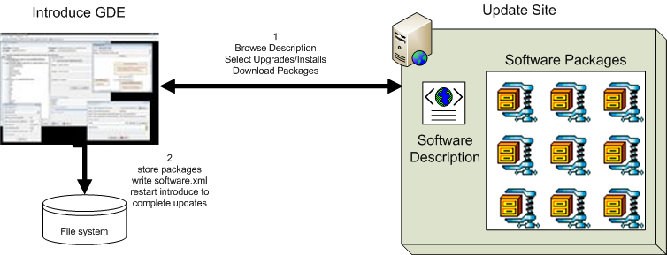
Introduce Software Updater
Update support enables introduce to role updates out and move to newer versions of itself and it’s extensions.

Slide 17
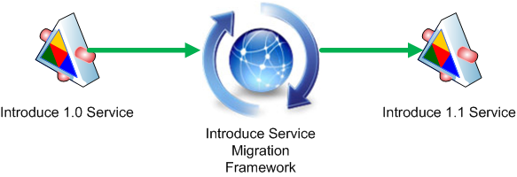
Introduce Service Migration
Introduce Service Migration Framework enables introduce and it’s extensions to provide upgraders which can run against services built with older versions of introduce and/or it’s extensions and migrate the services forward.
1.0 services and forward will now be able to be migrated to work with newer versions of introduce with very little effort on the developers part.

Slide 18
Recap Core Service Architecture
Base service is a GT4 based WSRF capable grid service.
Utilize compositional inheritance, “operation importing” (in lieu of non-standard port type extensions) to enable the service to inherit required features such as providing service security metadata and access to resource properties.
Utilize JNDI for registration configuration, server side configuration properties, and resources and resource properties.
Provide client and service side wrappers which implement the service designers interface as opposed to the document literal interface generated by Axis.
Provide metadata registration to the index service by configuring the Resource to register it’s service groups to a predefined MDS based Index Service.
ServiceSecurityMetadata and it’s access operation enables programmatic bootstrapping of connection security configuration.

Slide 20
Grid Enablement process
An algorithm which is not connected to the grid.
Grid
API

Slide 21

Exposing the Resource:
We will use the Introduce to describe the service and generate a grid service.
Grid
API

Slide 22

Exposing the Resource:
Will locate the schemas which describe the data models and will provide the wire protocol for transferring data instances.
GME
Grid
File System
API

Slide 23
Exposing the Resource:
Then we will describe the services layout, operations, security constraints, default properties, extensions, and service metadata .
Grid
API

Slide 24
Exposing the Resource:
Introduce will then generate the service which will be stubbed with the operations as described.
Grid
caGrid
Service
API

Slide 25
Algorithm now available.
Now that the service is generated we can put in our business logic to implement the service to utilize the algorithms we are wrapping.
Grid
GridService
caBIO
Grid Service
caGrid
Service
Service implementation
API

Slide 26
How will users find this new service
The services metadata can be registered to a caGrid Index Service so that a user/service can locate and use the service
Grid
GridService
caBIO
Grid Service
caGrid
Service
Service implementation
API

Slide 27
How will users find this new service
When the service starts up in the container it will automatically register its metadata to a caGrid Index Service.
Grid
GridService
caBIO
Grid Service
caGrid
Service
Service implementation
API
Index Service

Slide 28
Service Creation Demonstration
Service Creation Demonstration:
create a simple service
Notes:
Lets create a simple helloword service just to exercise the use case.

Slide 29
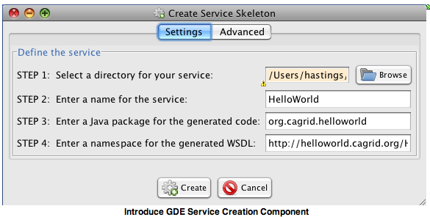
Service Creation

Slide 30
Service Creation
Creation Directory The creation directory is the location of which the grid service will be generated.
Service Name Service name is the name that will be used to generate the service. The service name must be a valid java identifier.
Package Name The package name is the base package to be used when generated the grid service source code.
Namespace The namespace is the namespace to be used when defining the WSDL of the service.

Slide 31
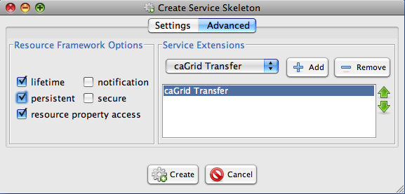
Advanced Service Creation
The advanced creation tab enables the developer to add specific extensions to the service such as Transfer or Enumeration capabilities as well as select the resource framework options like lifetime management and persistence capabilities.
Extensions and resource framework options can be changed after a service is created so it is not critical to get all the extension you might want added at this point but is helpful if you know what you are trying to build.

Slide 32
Introduce Service Creation Architecture
The Introduce Service Properties are a set if base properties
required for creating this service such as desired location to
create the service, namespace to use, package name to use,
and service name.

Slide 33
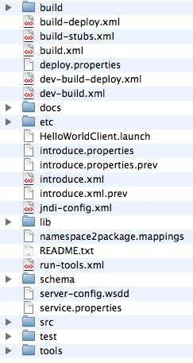
Generated Service
Master service deployment ant file
Master service build ant file
User editable deployment ant file
User editable build ant file
Client launch file for eclipse
Introduce service properties file
Introduce service model
JNDI file used for configuring the resources of the services that Globus will load.
Services libraries
Namespace to package mapping file used for creating beans.
Axis deployment configuration file
Properties for the service deployment that are unique to the service.

Slide 34
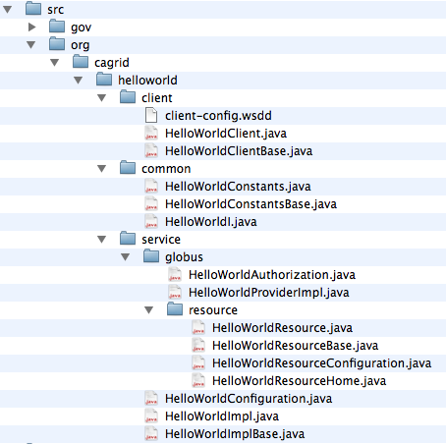
Generated Source Directory

Slide 35
Generated Source Directory
The client package contains all code which is specific to only using the client API.

Slide 36
Generated Source Directory
The common package contains code that is used by both the client and the service.

Slide 37
Generated Source Directory
The service package contains the code which is specific to the implementation of the service and is not needed by the client.

Slide 38
Generated Source Directory
The client-config.wsdd provides the client side configuration for the java bean to serialization mapping. This file will be used by default on the client to configure axis’ serialization however the client can forced to use an alternative configuration if so desired.

Slide 39
Generated Source Directory
Client java file that contains the implementation of the client API. This is what a developer would use to leverage the service in their application. The service developer can add operations to this file but cannot modify the operations that Introduce generates.

Slide 40
Generated Source Directory
Client Base java file. This file contains all the core methods for configuring the connection to the service such as port type configuration for security and retrieval of the security metadata used for port type configuration. This also contains utilities for subscribing for notifications to the service. This class is managed by Introduce and is not editable by the user as Introduce will regenerate it after every save from Introduce.

Slide 41
Generated Source Directory
The Constants class is a class where the user can add constants they might want to use in either the service and/or the client. The Constants class is user editable and extends the generated Base class.

Slide 42
Generated Source Directory
The Constants Base class is generated by Introduce and contains Qnames for all the resource property types as well as the service itself that the client and service will want to use.

Slide 43
Generated Source Directory
The service basic interface is the interface that the client will implement to provide the operations used to communicate with the service. This interface represents the interface that the developer described in the Introduce application.

Slide 44
Generated Source Directory
The authorization class is used by the service to determine if a user is authorized to invoke a particular operation. The authorization class is used by the Introduce PDP (Globus’ Policy Decision Provider) when a call is made to the service. It is auto generated by Introduce and should not be edited manually.

Slide 45
Generated Source Directory
The provider impl class is an implementation of the port type automatically generated by Introduce. This implementation unwraps the document literal calls into the Globus/Axis service and maps those to the RPC style calls described by the user which are implemented in the services impl class.

Slide 46
Generated Source Directory
The Rosource class extends the base resource and gives the developer a location to add custom business logic for the resource instances of this service.

Slide 47
Generated Source Directory
The Resource Base class is auto generated by Introduce and should not be altered. It contains the logic required for the resource to load and restore itself as well as the resource property instances and there topics required for notification support.

Slide 48
Generated Source Directory
The Resource Configuration class is a bean that is loaded via JNDI and should not be edited. It contains the configuration properties for the resource like should the resource perform registration to an index service when it is created.

Slide 49
Generated Source Directory
The Resource Home class provides the functionality of creating new resources, locating them, storing them and reloading them. It is the resource manager for the service instance. It is an Introduce managed class and should not be edited.

Slide 50
Generated Source Directory
The Configuration class is where any preset service property values can be accessed. It is also loaded via JNDI and should not be altered. It can be accessed anywhere within a service or its resources statically.

Slide 51
Generated Source Directory
The Impl class is where the developer will be able to put the business logic for implementing the operations and functionality of the service and it extends the Impl Base class. A method will be stubbed for each operation the developer described within Introduce and this is where the developer will put the implementation. These are the first area the developer will receive in coming calls to the service.

Slide 52
Generated Source Directory
The Impl Base class contains the basic generated functionality of the service such as access to the Resource Home and Configuration.

Slide 53
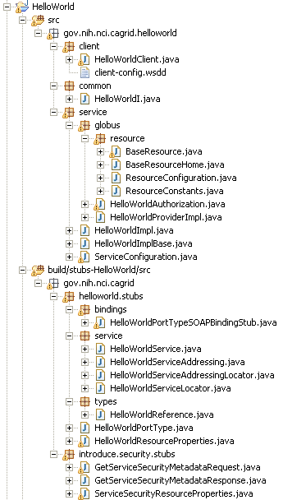
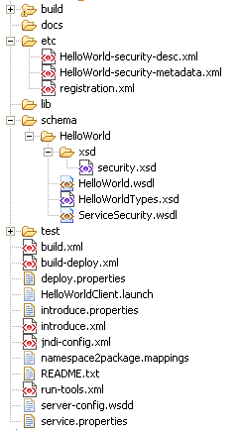
Created Skeleton Layout
= introduce managed
= globus/axis managed
= developer implements

Slide 54
Created Skeleton Layout (cont)
= service metadata registration configuration
= describes the services security configuration
= services WSDL file for axis
= introduce properties for this service
= ant build files
= client configuration file for axis
= deployment time service properties
= introduce representation of service
= JNDI service resources configuration
= namespace mappings for axis
= server configuration file for axis

Slide 55
Inside the Introduce created service
Services have many moving and configurable parts which support features such as:
Advertisement
Discovery
Invocation
Security (Authentication/Authorization)
Stateful Resources
The Introduce Toolkit can keep all these features in sync as the developer creates and modifies the grid service

Slide 56
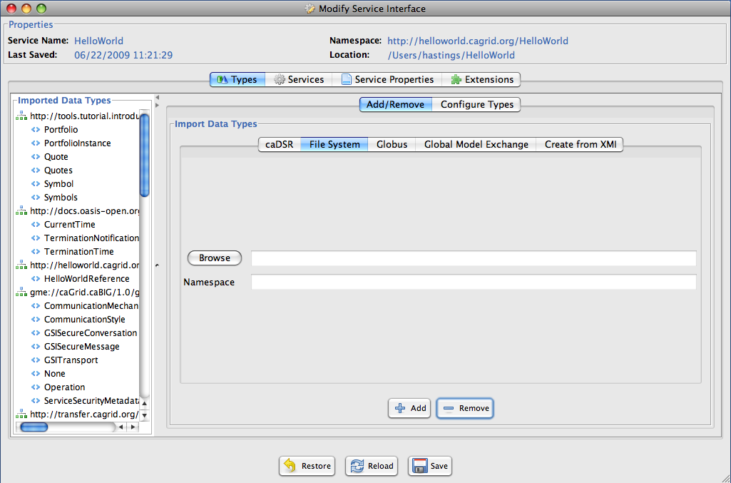
Modification
Add/Remove/Modify
Data Types
Operations
Resource properties
Service properties
Service contexts (services and resources)
Service, method, and resource level security configuration

Slide 57
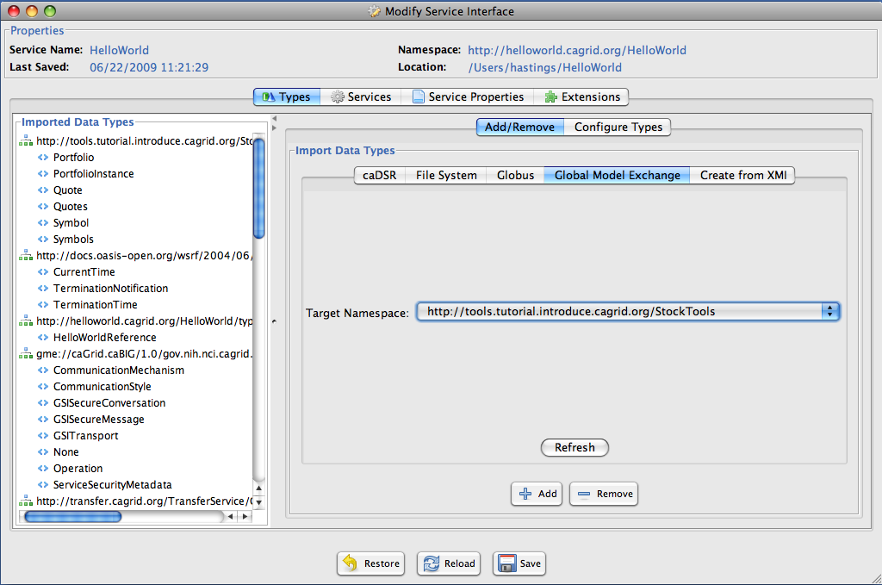
Data Types Importing
Types tab enables the adding removing and configuration of the data types that can be used in the development of this service. The data type discovery extensions show as tabs under the Add/Remove tab. These extensions provide capabilities to retrieve schema for data types from different providers such as the GME or the local file system.

Slide 58
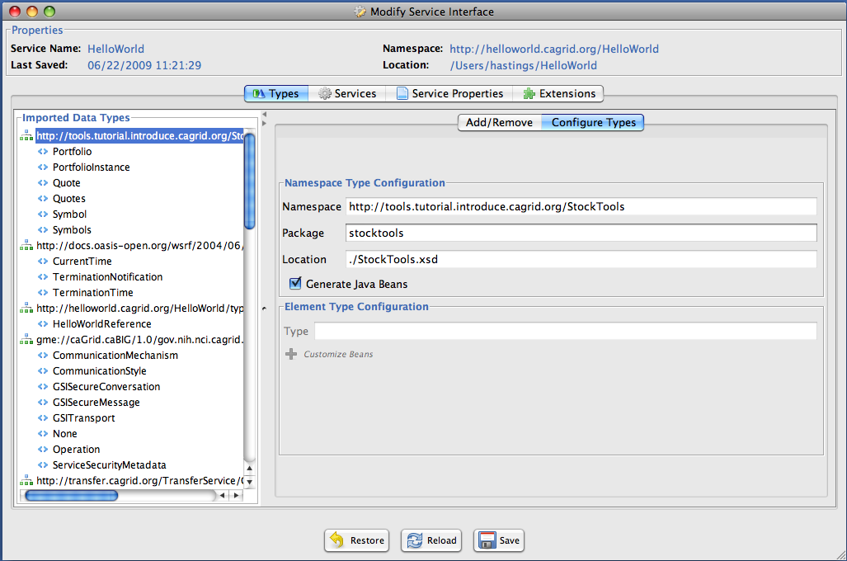
Data Types Configuration
The Configure Types tab enables the packages to be configured for the namespace selected on the types tree. This tab also enables disabling bean generation and leveraging existing beans and existing serializers and deserializers.

Slide 59
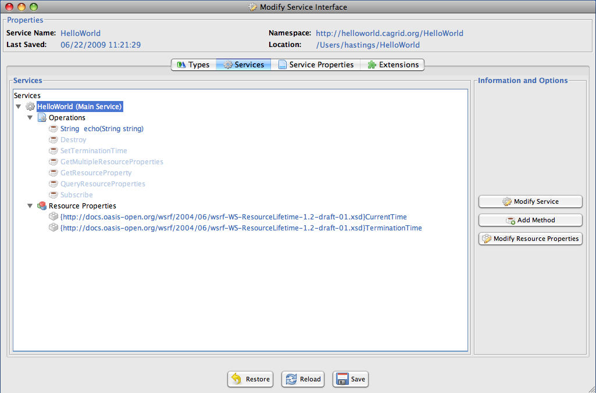
Designing the Service
The Services tab enables the addition/removal/modification of operations on the base service as well as adding other service contexts.
The Resource Properties of a particular service type can also be added/removed/and modified.
The imported operations of the service are shown translucent as the operations the user has added are shown in bold

Slide 60
Modifying the Service
By selecting a service in the services tree on the left and selecting the Modify Service button on the right a user can modify/configure the service

Slide 61
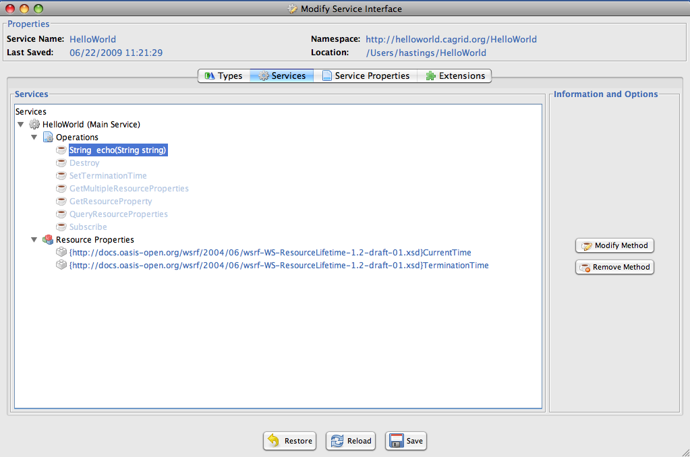
Modifying an operation
By selecting an operation from the services tree on the left and selecting the Modify Method button on the right a user can modify the operation.

Slide 62
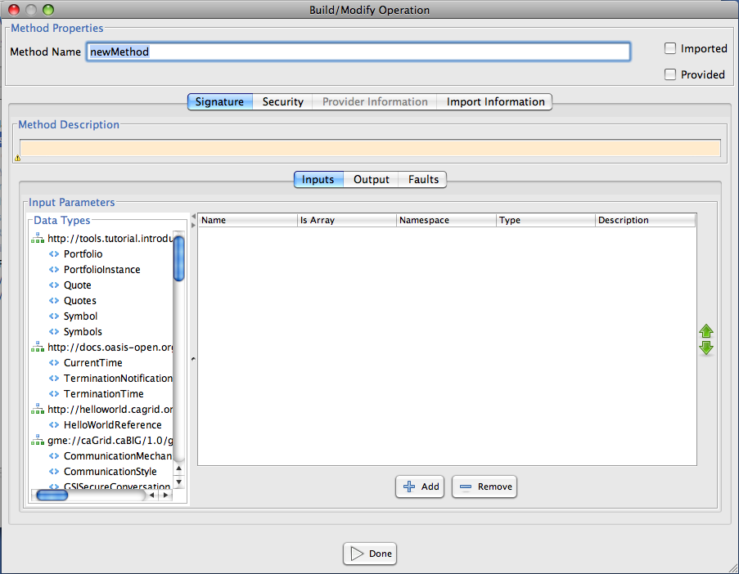
Modifying an operation
The Operation Modification Viewer enables all aspects of the operation to be manipulated from the name to the data types that the operation will consume and produce.
The Viewer also enables operations to be imported from other WSDL files or Introduce services as well as the implementation of an operation to be Provided by a class.
The Signature tab is specifically used for designing the operation signature, i.e. it’s inputs outputs and faults.

Slide 63
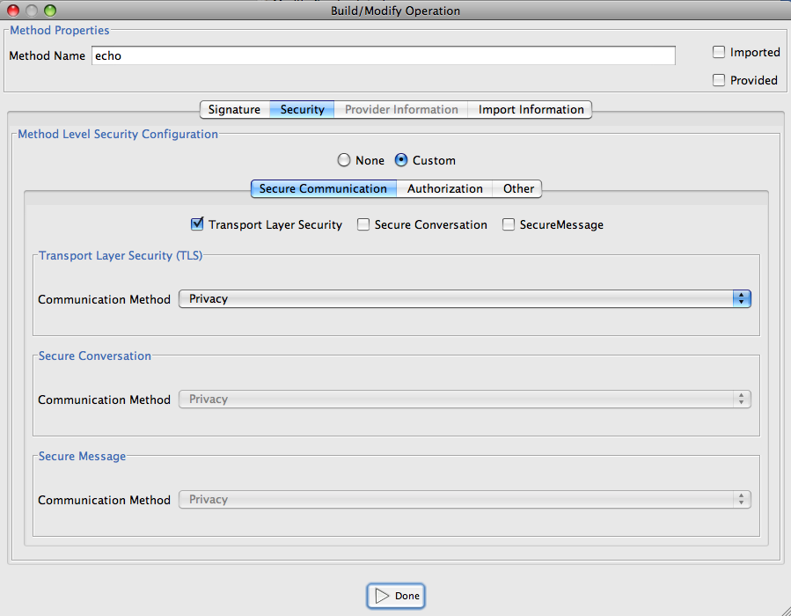
Modifying an operation
The Security Tab provides for configuration of the operations default security configuration.
The Secure Communication Tab enables the developer to describe what the requirements are to communicate to the method such as TLS and Secure Conversation both with Privacy.
This Tab is essentially setting the GSI configuration for the policy the service will use for connecting to this operation.

Slide 64
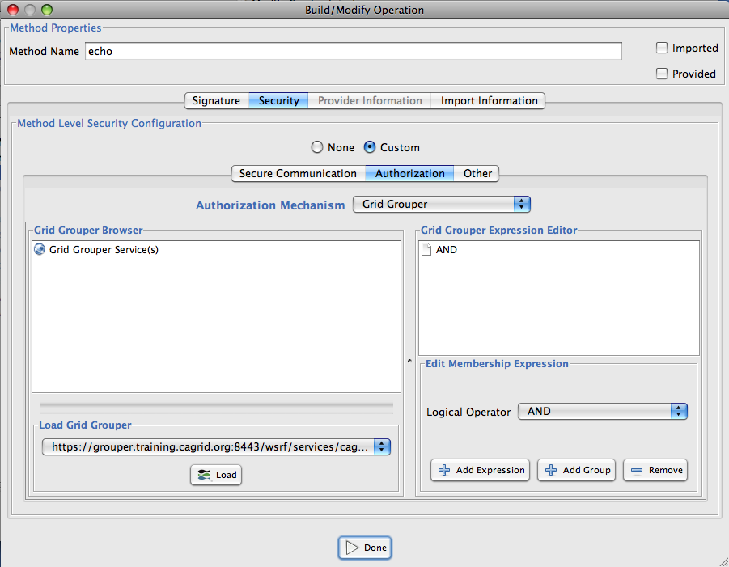
Modifying an operation
The Authorization Tab under the Security Tab enables the configuration of an authorization policy for the operation.
Authorization extensions provide plug-in in tools for adding customized authorization types such as Grid Grouper.
The extensions provide graphical views to enable the authorization policy configuration easy.
A custom PDP can also be used and the class name of the PDP can simple be provided in the CustomPDP mechanism.

Slide 65
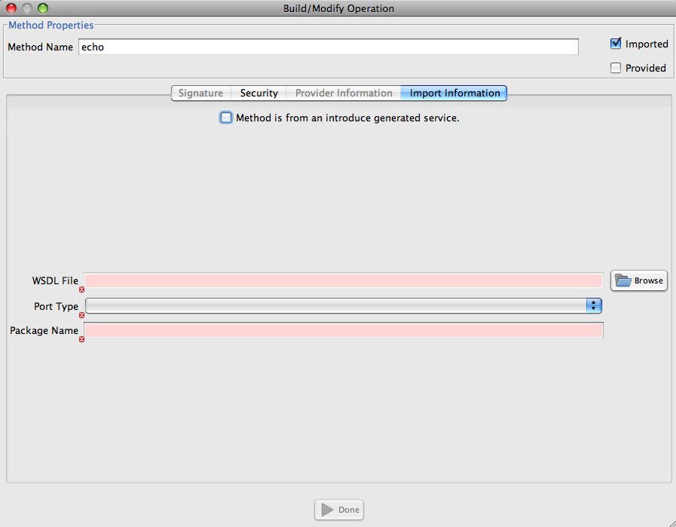
Modifying an operation
The Import Tab of the Operation Modification viewer enables an operation to be defined by importing it from another WSDL or from another Introduce service.
Once this operation is imported it will have the same signature as described by the WSDL it was imported from.
This operation will be able to be communicated with from any other client using the same WSDL.
The Security configuration can be further customized.

Slide 66
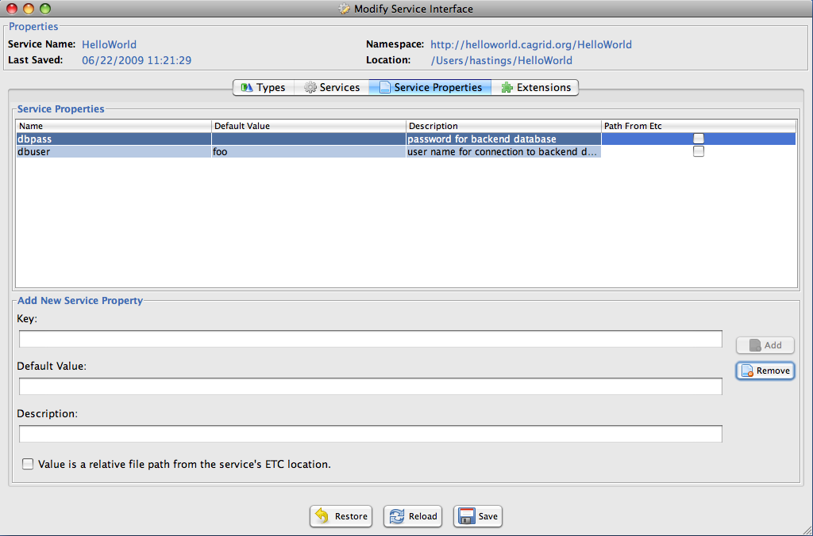
Modifying Service Properties
The Service Properties Tab of the Modification Viewer enables the user to add properties to the service which may be used for deployment time configuration.
These properties can be defaulted in the viewer but can also be populated at deployment time.
The properties are accessible but this service and any of its service contexts.

Slide 67
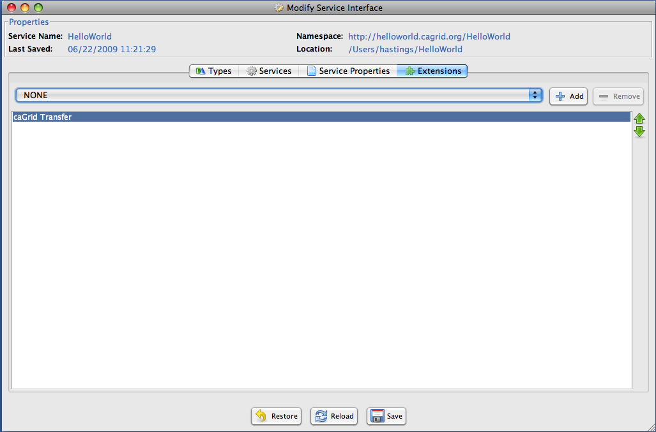
Adding / Removing Extensions
The Service Properties Tab of the Modification Viewer enables the user to add properties to the service which may be used for deployment time configuration.
These properties can be defaulted in the viewer but can also be populated at deployment time.
The properties are accessible but this service and any of its service contexts.

Slide 68
Adding / Removing Extensions
After every cycle of adding or removing functionality to the service you must save the service in Introduce in order for the synchronization engine to update your services generated code.

Slide 69
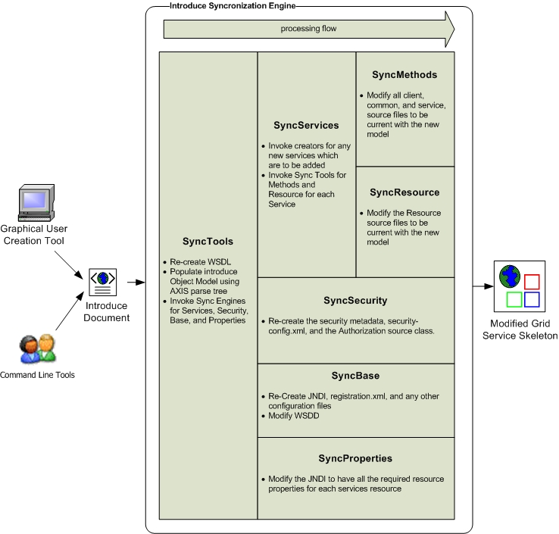
Introduce Service Modification Architecture
The Introduce Service Description document is the input to the introduce engine. The user can hand craft this document and call the engine via command line or API or can use the Introduce GDE to create and modify this document and execute the synchronization engine

Slide 70
Service Modification Demonstration
Service Modification Demonstration
Implement a service’ operation
Notes:
Implement a helloworld client that we can use for testing.

Slide 71
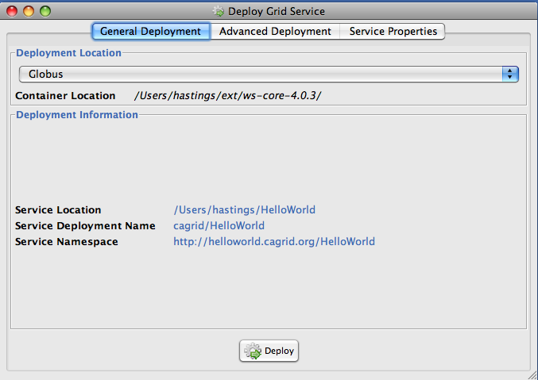
Deploying a service.
In the Deployment Viewer the General Tab show the basic information about what it is about to deploy and give the user an option of available contains to deploy to.

Slide 72
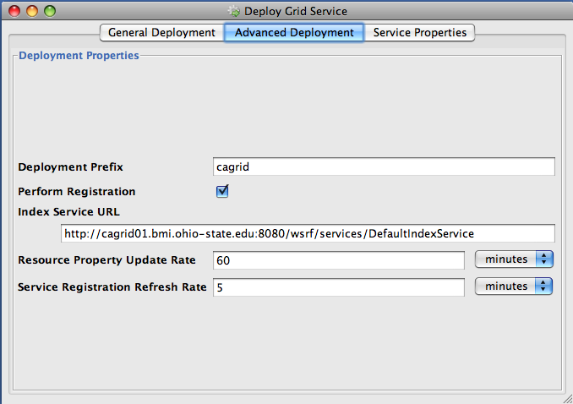
Deploying a service.
The Advanced Deployment Tab enable the user to configure the deploy prefix, a unique name for this service instance, and the properties related to the index service registration.

Slide 73
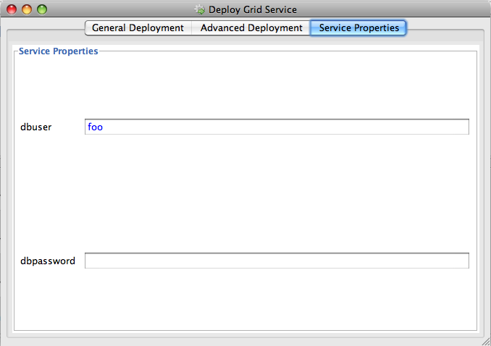
Deploying a service.
The Service Properties Tab enables the user to configure any of the services properties that the service has specified and is expecting values for at runtime.

Slide 74
Deploying a service.
Once the options for the deployment have been configured the user can select the Deploy button from the General Deployment Tab in the Deployment Viewer.

Slide 75
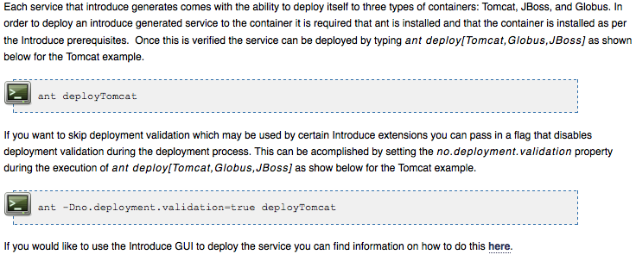
Deploying a service (command line)
Introduce services use ant as the build deploy process. An introduce service an be deployed by typing “ant deploy<ContainerType>” from the root of the service directory.

Slide 76
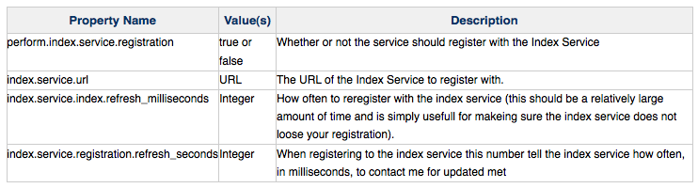
Deploying a service (command line)
Services can be configured prior to deployment by editing the deployment.properties file. This file provides configuration for index service registration. The service.properties file can also be edited prior to deployment to edit the service properties defined in the service.

Slide 77
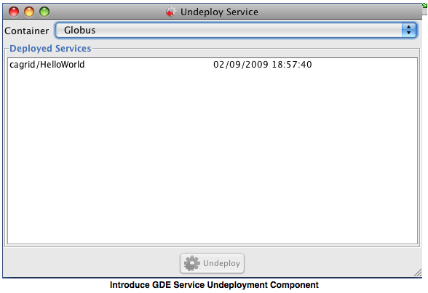
Service Undeployment
The introduce GUI will enable you to browse for deployed services in specific container and choose them for undeployment. Introduce will then undeploy the service and all its dependencies from the container.

Slide 78
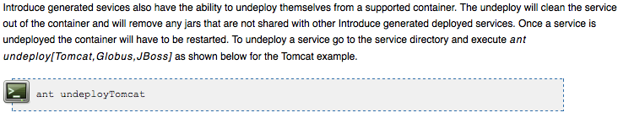
Service Undeployment (command line)
Services are also able to be undeployed from a container. You need to go to the service root directory and type “ant undeploy<ContainerType>” to remove the service and all its dependencies from the container.

Slide 79
Service Deployment and Invocation Demonstration
Service Invocation Demonstration
Implement client test function
Notes:
Implement a helloworld client that we can use for testing.

Slide 80
Recap
Created service with introduce.
Deployed service.
Started container.
Implemented client test function.
Invoked client against our new service.

Slide 81
Stateful Web Services
A resource is an independent entity stored by the container which stores state information.
A Web Service is a stateless open standards interface allowing to access web-based applications.
A WS-Resource is the pairing of a Web-Service with a resource, effectively making the pair accessible and stateful.

Slide 82
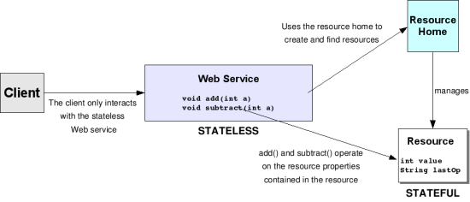
Stateful Web Services
Introduce generated stateful services utilize a resource home to manage the resource instances for a service. The resource home can be used to create new instances of the resource as well as to look up and use instances that are being referred to by the client.

Slide 83
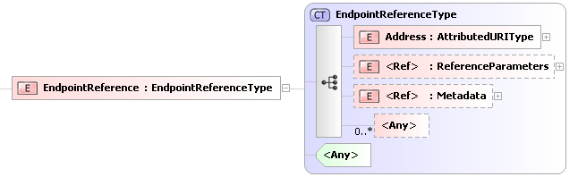
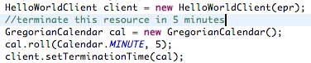
Stateful Web Services
The client can uniquely identify the resource they would like to act on by using an EPR when connecting to the service. The EPR contains the information for locating the service as well as the id for the resource containing the state they would like to act on.

Slide 84
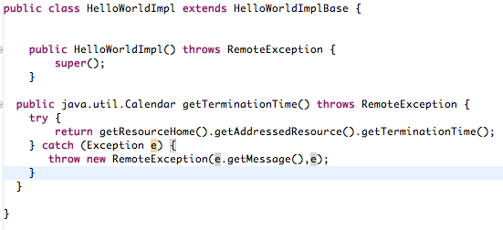
Stateful Web Services
The service can use the resource home to locate the state the client is trying to act on and use that resource when implementing the business logic.

Slide 85
Service Contexts
Introduce calls service contexts all other services developed within one introduce projects except for the primary (first) service.
Service contexts share the service configuration i.e. service properties of the primary service.
Service contexts know how to access every other service contexts and the primary service resource home in order to factory new resources, find resources, and get the currently addressed resource.
Service contexts will each independently register with index service using the same configuration as the primary service.
Service contexts do have resource properties just like every other service and have operations just like every other service.
Service contexts all have there own unique endpoints and to the outside world are unique web services indistinguishable from the fact they were developed and bundled together.
Service contexts are all developed and build within the same Introduce project as the primary service.
Service contexts are all deployed together with the primary service to the grid service container.

Slide 86
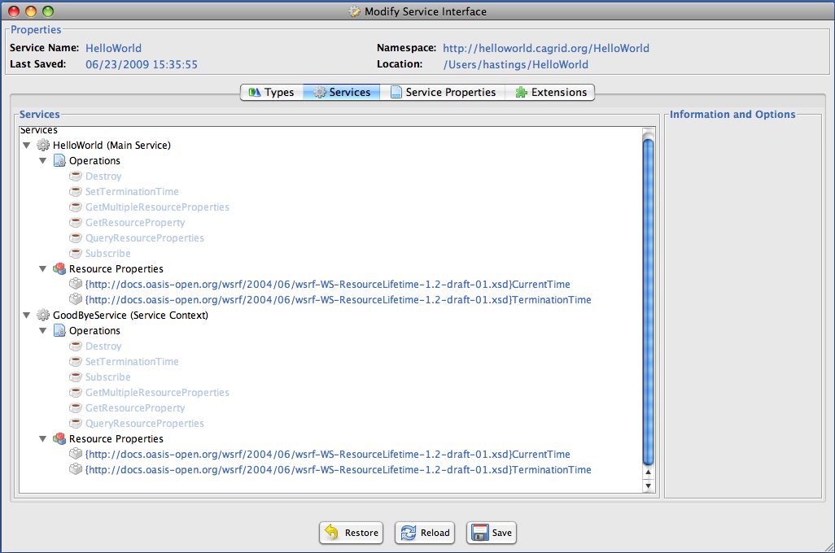
Service Contexts

Slide 87
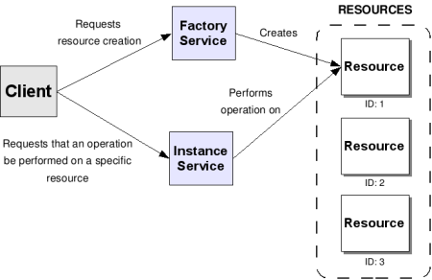
Resource Factories

Slide 88
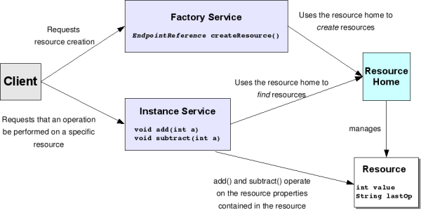
Resource Factories

Slide 89
Stateful Web Services

Slide 90
SHOW INTRODUCE FACTORY CODE THAT IS GENERATED.

Slide 91
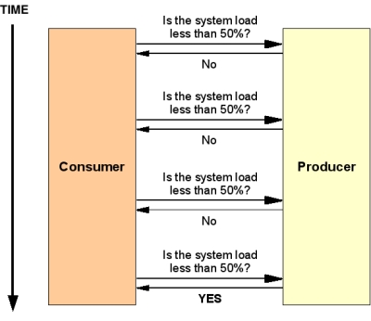
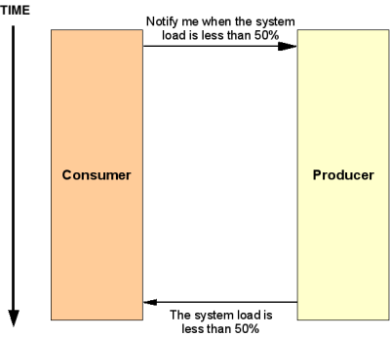
Notification
Introduce leverages the WS-Notification specification and Globus support for to enable clients to be notified of events on services.

Slide 92
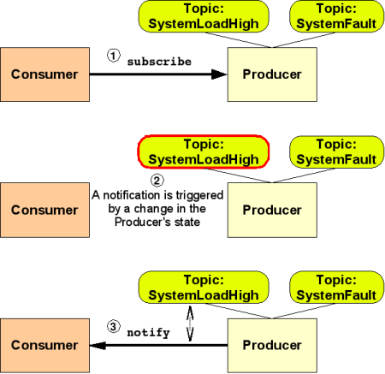
Notification
Globus provides implementations for utilizing Topics for registering for notifications.

Slide 93
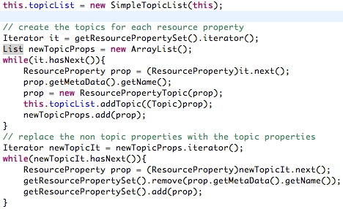
Notification (cont.)
Server Side
Introduce utilizes Topics and converts all the resource properties to topics so that they can be subscribed to via the qname of the resource property.
Custom Topics representing events or changing values can be created by the developer in the Resource and can then be subscribed to from the client.

Slide 94
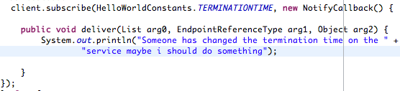
Notification (cont.)
Client Side
The client can use the subscribe method to be notified of any changes to a particular resource property on the resource of a service. The client will call the subscribe operation and pass in the Qname of the Topic they would like to listen for Notifications on. Once the service fires a Notification due to an event such as a changed value the client will be called back and Notified of the change.
When subscribing the client should provide an implementation of the NotifyCallback interface so they can receive the messages in the client or application.

Slide 95
Persistence
Resources can be persistent. Persistent resources can be stored and retrieved so that they can outlast any particular running instance of a container. The ResourceHome will retrieve the resources as requested via the find operation and the Resource will persist itself on any changes. This enables the grid service to survive reboots and unforeseen outages and still operate as if nothing happened.
retrieve
resources
Store resource

Slide 96
Persistence
On any changes in the Resource that will effect the Resource the Resource must call store on itself in order for those new changes to be persisted. Introduce will call store automatically on any resource property changes that it manages and the developer should do the same on any changes to Resource local variables that are changed by calls to the Resource such as internal counters or boolean values.
retrieve
resources
Store resource

Slide 97
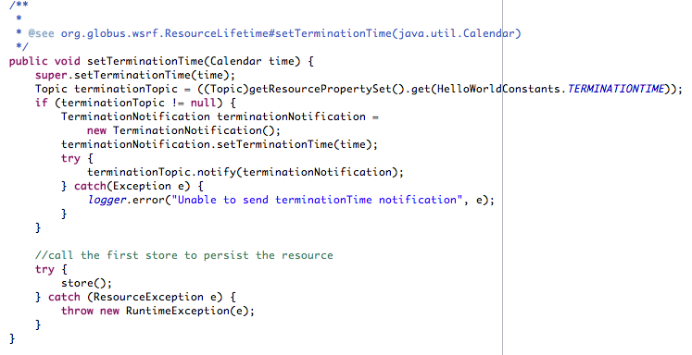
Persistence
An ResourceBase example operation that Introduce generated for a ResourceProperty that knows the Resource is persistent and calls store on itself.

Slide 98
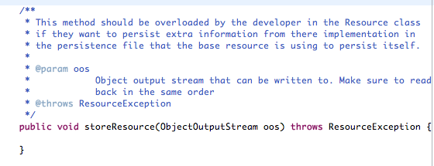
Persistence
Introduce will automatically write the resource properties of each resource to a file in the etc directory of the container deployment for that service. The developer can then override the storeResource/retrieveResource operations in the resource class to persist other local variables or data relevant to the resource so that it can be successfully retrieved.

Slide 99
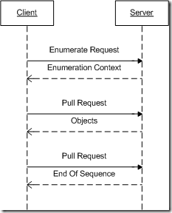
Enumeration
Introduce includes an extension that can enable the service to easily enumerate objects back to the client in a pull based mechanism.
This enables the load to be managed by the client and gives the client an interface to pull the results one at a time.
The support is built using the WS-Enumeration specifications.

Slide 100
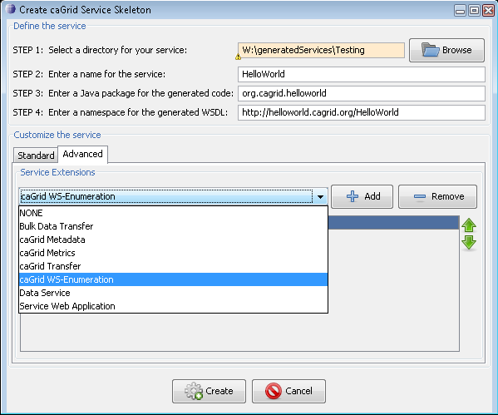
Enumeration
To enable enumeration support the service developer must first add the extension to the service.
This can be done at creation time or in the modification viewer anytime after creation.
Once the extension has been added the developer must hit save in the Introduce GUI in order to have the extension installed.

Slide 101
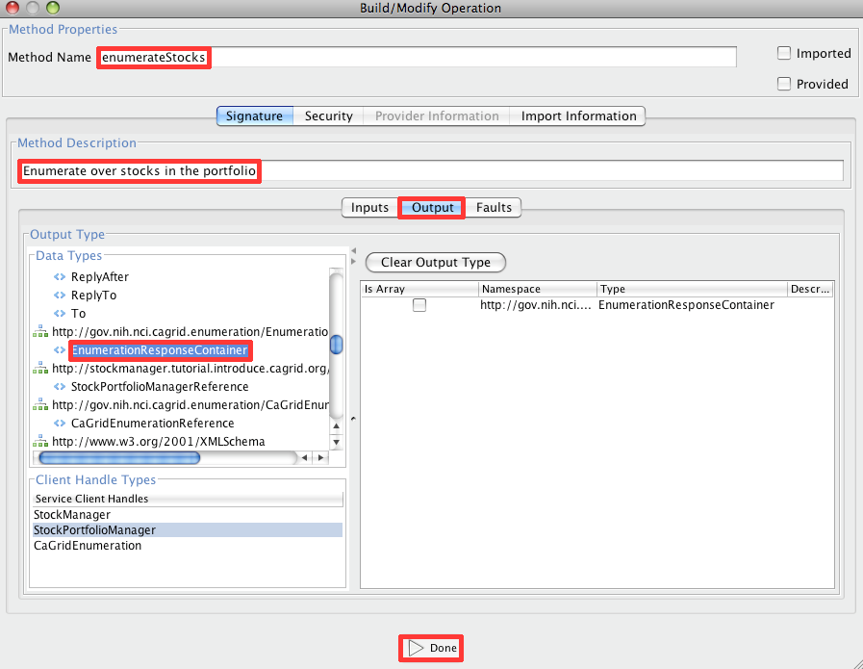
Enumeration
In order for an operation to return something that can be enumerated the return type on the operation should be EnumerationResponseContainer
This will enable the client to retrieve the response and use it get a handle to the enumeration client and use that to retrieve the results.
The service will be able to use enumeration tools to create this enumeration response container and return it to the client.

Slide 102
Enumeration
caGrid WS-Enumeration supplies the factory class gov.nih.nci.cagrid.wsenum.utils.EnumIteratorFactory which creates concrete instances of the EnumIterator. The factory method createIterator() takes parameters to determine the type of implementation, as well as the list of data objects to be enumerated (or a java.util.Iterator to the same), the XML QName of those objects, and a WSDD configuration stream to manage the serialization of the data objects.

Slide 103
Enumeration
* GLOBUS_SIMPLE
o The Globus-provided simple enum iterator
o A concrete implementation of the EnumIterator interface. It is a very simple implementation that can enumerate over in-memory data passed either as an array of objects or a list (java.util.List). The enumeration contents can be of javax.xml.soap.SOAPElement type, simple types such as java.lang.Integer, etc. or Axis generated Java beans. The SimpleEnumIterator can only be used with transient type of enumerations.
* GLOBUS_INDEXED_FILE
o The Globus-provided indexed file enum iterator
o A memory efficient implementation that can enumerate over data stored in an indexed file created by IndexedObjectFileWriter. The indexed file format is optimized for retrieving objects in a sequential and random manner. The IndexedObjectFileEnumIterator uses the IndexedObjectFileReader to read the indexed file and quickly locate and retrieve the next set of objects of the enumeration. The IndexedObjectFileEnumIterator can be used with transient and persistent types of enumerations.
* CAGRID_SIMPLE
o A simple iterator which persists objects to disk
o This iterator makes no attempt to respect any values of IterationConstraints except for maxElements.
* CAGRID_THREADED_COMPLETE
o A relatively complete implementation of the EnumIterator spec
o This iterator uses threads to respect maxTime constraints, as well as respecting maxCharacters. Elements overflowing either of these constraints, however, are lost, and waits for threads are not optimized.
* CAGRID_CONCURRENT_COMPLETE
o The default and most complete implementation of the EnumIterator spec
o This iterator uses the Java 5 java.util.concurrent package to fully support the WS-Enumeration specification for an EnumIterator implementation. All iteration constraints are respected, and elements which cause maxCharacters to be exceded are queued for later retrieval.

Slide 104
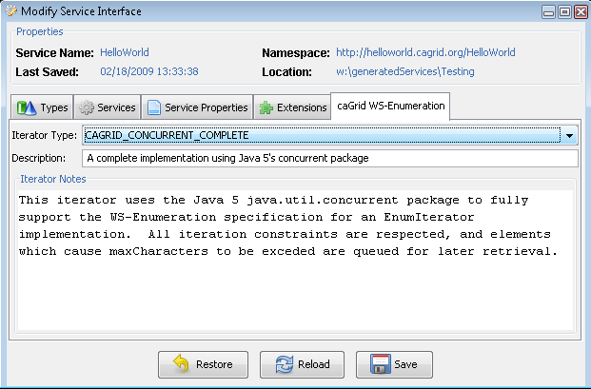
Enumeration
A prebuilt enumerator can be used to aid in the service side enumeration of the objects.
caGrid comes with some prebuilt enumerators or the developer can create their own custom enumeration support in the service.
The enumeration tab provides support for selecting one of the predefined enumerators which will inform the EnumIteratorFactory helper code which enumerator you would like to use in your service by default.

Slide 105

Enumeration
Example service side code utilizing the EnumIteratorFactory to create an enumerator that will enumerate a list of strings to the client on request.

Slide 106

Enumeration
Example client code utilizing the EnumerationResponseHelper to get an client side iterator that can be used to iterate the results from the server.

Slide 107

Transfer
Motivation
Many user groups in caGrid have expressed the need to transfer large data files in the grid without paying the penalty of serialization or deserialization time and memory usage. Early on in the project we created support for utilizing GridFTP for solving these usage scenarios. Several issues with this current approach left us searching for another solution. Some of the issues are as follows:
* caGrid BDT uses GridFTP as the underlying third-party transfer mechanism.
o GridFTP server is not cross platform (currently on on C platform builds of globus).
o GridFTP requires a separate globus-C installation as caGrid uses the JavaWS Core installation of globus.
o GridFTP has to be extended to be able to make authorization callouts to a Java-based middleware such as caGrid.
o GridFTP installation and configuration is quite advanced for our user community.
* Globus does not currently support SOAP attachments.

Slide 108
Transfer
Features
In order to better serve our user group we have come up with the following requirements for an alternative non-grid high performance delivery mechanism:
* Cross platform (utilize the container that will be hosting JavaWS Core Globus).
* One click/command install with no required configuration.
* Work within the same web application container as caGrid is deployed.
* Utilize GSI sockets for securely transporting the data using the same proxy certificates issued in caGrid.
* No deserialization or serialization required on server or client.
* No minimum requirement for core memory.
* Support upload and download of data.

Slide 109

Transfer
The transfer service architecture consists of a transfer grid service and a transfer web app.
The grid service contains the logic to manage the transfers that are happening in the container.
The webapp is used to handle the data requests and stream the data over http(s)

Slide 110

Transfer
In order to enable Transfer capability in your service you must add the Transfer extension to the service either at creation time or any time during modification. Once it is added hit the save button so that Introduce can add the transfer support to your service.

Slide 111

Transfer
Once transfer capability is added to the service you can create an operation that returns a TransferContextReference.
Returning a transfer context reference will enable the client to use this reference to create a helper instance that will help with retrieving the data from the service.

Slide 112

Example Usage
Step 1: In Introduce you must first add the caGrid Transfer extension to the service. This can be done by selecting the extensions tab of Introduce, adding the caGrid Transfer extension, and saving the service.

Slide 113
Example Usage (download)
Step 2: Add a method to the service that will return a TransferServiceContextReference. This can be acomplished by:
Selecting the services tab,
Select the service you wish to use Transfer with,
Select the “Add Method” button.
Make the method take in what ever inputs are required to produce the data you which to send to the client.
Make sure you select the TransferServiceContextReference as the output type of the operation.
Select Done on the Method Viewer
Select Save on the Introduce Modification Viewer.
Now we have added an operation to your service that returns a Transfer reference which a client can use to retrieve data from.

Slide 114
Example Usage (download)
Step 3: Implement the method on the service so that it can produce the data to return the client, stage that data to the Transfer Service Webapp, and return the new TransferContextReference to the Client.
public org.cagrid.transfer.context.stubs.types.TransferServiceContextReference getSomeData() throws RemoteException { // create some data to sent
byte[] data = new String("This is my bulk data").getBytes();
// create a descriptor for that data
DataDescriptor dd = new DataDescriptor(null, "My Data");
// create the transfer resource that will handle delivering the data and // return the reference to the user
return TransferServiceHelper.createTransferContext(data, dd);
}

Slide 115
Example Usage (download)
Step 4: Implement the client so that it can retrieve the TransferContextReference, get a handle to the TransferContextClient, and use the TransferClientHelper to retrieve the data the service has prepared.
HelloWorldClient client = new HelloWorldClient(args[1],GlobusCredential.getDefaultCredential());
// create transfer is a method that staged some data and returned the Reference
TransferServiceContextReference ref = client.getSomeData();
// create a client that enables me to talk to my transfer resource TransferServiceContextClient tclient = new TransferServiceContextClient(ref.getEndpointReference(),GlobusCredential.getDefaultCredential());
// use the TransferClientHelper to get an InputStream to the data
InputStream stream = TransferClientHelper.getData(tclient.getDataTransferDescriptor(),GlobusCredential.getDefaultCredential());

Slide 116

Transfer Deployment
When a service utilizing the Transfer capability is deployed to a container the Transfer helper services must also be deployed to the container, i.e. the Transfer Service and the Transfer WebApp.

Slide 117

Transfer Deployment
The transfer grid service has some configuration properties that can be altered prior to it’s deployment. Simply edit the service.properties file and redeploy the transfer services.

Slide 118
Service Authorization
The Globus authorization framework enables configuring Policy Decision Provider Chains (a list of classes that will be invoked for a true false value which are deciding whether or not to grant access to the caller) to be used to protect access to a service, method, or resource.
Access protection is always resource first, then method, then service.
For instance, if a resource instance is configured with a PDP Chain that chain will be invoked if the resource is being accessed even if there is a PDP chain for the operation . The lowest level of protection is resource, then operation, then service.
Introduce enables configuring PDP chains on the service and methods and has example of how to hook chains into resources as they are created.

Slide 119
Secure Resource
In order to add a PDP to a resource it must be done dynamically as resources are created dynamically. Introduce provides some basic utilities to enable services to protect resources to only be accessible by the caller that created them. This enables community services to factory resources which are private to the caller.
thisResource.setSecurityDescriptor(gov.nih.nci.cagrid.introduce.servicetools.security.SecurityUtils.createCreatorOnlyResourceSecurityDescriptor());

Slide 120

Service Authorization
The services security configuration file configures the Globus PDP chains for the service and operation levels.
This file “<serviceName>-security-desc.xml” is auto generated by Introduce and lives in the etc directory of the service.

Slide 121

Service Authorization
Introduce provides a PDP that is extendable and comes with plugins that know how to authorize users based on many different external resources such as GridGrouper or CSM or through other policies such as enforcing that the user is not connecting anonymously i.e. has been authenticated by a trusted identity provider.

Slide 122
Extension Development

Slide 123
Types of Extensions
Introduce supports different types of extensions
Discovery DataType
Service
Resource Property Editor
Authorization
Deployment
Introduce GDE Extension

Slide 124

Discovery DataType

Slide 125

Service

Slide 126

Discovery Schema

Slide 127

Service Schema

Slide 128

Resource Property Schema

Slide 129

Authorization Schema

Slide 130

Deployment Schema

Slide 131

Introduce GME Schema

Slide 132
To Create Your Own Extension
mkdir –p $CAGRID_HOME/projects/<YOUR EXTENSION>
cd $YOUR_EXTENSION
mkdir extension
mkdir src
Copy build.xml, dependencies-build.xml, ixy.xml, project.properties from another project into your extension root dir

Slide 133
For Discovery DataType
You’ll need to extend the class NamespaceTypeDiscoveryComponent
Create extension.xml in extension
Should have contents similar to the following:
<ns1:ExtensionDescription xmlns:xsi="http://www.w3.org/2001/XMLSchema-instance" version="1.2"
xmlns:ns1="gme://gov.nih.nci.cagrid.introduce/1/Extension" extensionType="DISCOVERY">
<ns1:DiscoveryExtensionDescription displayName="caCORE SDK" name="mapping">
<ns1:DiscoveryPanelExtension>org.cagrid.mapping.portal.discovery.CaCoreSDKDataTypeSelectionComponent</ns1:DiscoveryPanelExtension>
<ns1:Properties>
<ns1:Property makeGlobal="true" key="CA_CORE_SDK_MAPPING" displayName="caCORE SDK Mapping" description="caCORE SDK Mapping" value="true"/>
</ns1:Properties>
</ns1:DiscoveryExtensionDescription>
</ns1:ExtensionDescription>

Slide 134
For ServiceType
You’ll need to extend several classes
Create extension.xml in extension
$CAGRID/projects/introduce/schema/Extension.xsd defines the schema for extension.xml and documents which files need to be extended or implemented.
Should have contents similar to the following:
<ns1:ExtensionDescription extensionType="SERVICE" version="1.3" xmlns:ns1="gme://gov.nih.nci.cagrid.introduce/1/Extension" >
<ns1:ServiceExtensionDescription displayName="Data Service" name="data">
<ns1:CreationPostProcessor>gov.nih.nci.cagrid.data.creation.DataServiceQueryOperationProviderCreator</ns1:CreationPostProcessor>
<ns1:CreationUIDialog>gov.nih.nci.cagrid.data.ui.creation.DataServiceCreationDialog</ns1:CreationUIDialog>
<ns1:CodegenPreProcessor>gov.nih.nci.cagrid.data.codegen.DataServiceCodegenPreProcessor</ns1:CodegenPreProcessor>
<ns1:CodegenPostProcessor>gov.nih.nci.cagrid.data.codegen.DataServiceOperationProviderCodegenPostProcessor</ns1:CodegenPostProcessor>
<ns1:ServiceModificationUIPanel>gov.nih.nci.cagrid.data.ui.DataServiceModificationPanel</ns1:ServiceModificationUIPanel>
<ns1:ServiceDeploymentUIPanel>gov.nih.nci.cagrid.data.ui.auditors.AuditorDeploymentConfigPanel</ns1:ServiceDeploymentUIPanel>
</ns1:ServiceExtensionDescription>
</ns1:ExtensionDescription>

Slide 135
UI
Introduce uses swing for its GUI.
Your extension will need to use JPanels to capture any user input

Slide 136
Configuration
Update the configuration files as necessary to include the necessary dependencies and project properties.

Slide 137
Building and Deploying the extension
From $CAGRID_HOME:
ant build-project -Dsingle.project.name=<YOUR_EXTENSION>
From $YOUR_EXTENSION:
ant installIntroduceExtensions
That will compile and deploy your extension to the Introduce extensions directory. When introduce is restarted it will read through the extension directories and parse the extension.xml files for extensions to add.
Start introduce and you should see your extension in the appropriate area.

Slide 138
More Information
http://cagrid.org
Tutorials
Documentation
Software Downloads
Support Forums
Much Much More

Slide 139
Additional Information
caGrid Website (http://www.cagrid.org)
Download Software
Documentation
Tutorials
Technical Paper and Presentations
caGrid Knowledge Center (http://knowledge.cagrid.org)
Technical Support and Guidance
caGrid Users Mailing List
https://list.nih.gov/archives/cagrid_users-l.html
cagrid_users-l@list.nih.gov

